Slide 1
Applies Data Structure and Application
Dr Sachin K Saxena Sr Data Analyst, Portugal, MNC
Ex-Sr Software Engineer - Data Scientist

Slide 3
Content
Sorting: Bubble Sort
Selection Sort
Insertion Sort
Merge Sort
Quick Sort
Heap Sort
Radix Sort
Shell Sort

Slide 4
Sorting: Definition and Processes
Sorting is the process of arranging data in a specific order, typically ascending or descending, to improve data organization and search efficiency.
Sorting (Bubble, Selection, Insertion, Merge, Quick, Counting, Radix) – VisuAlgo:
https://visualgo.net/en/sorting?slide=2-2

Slide 5
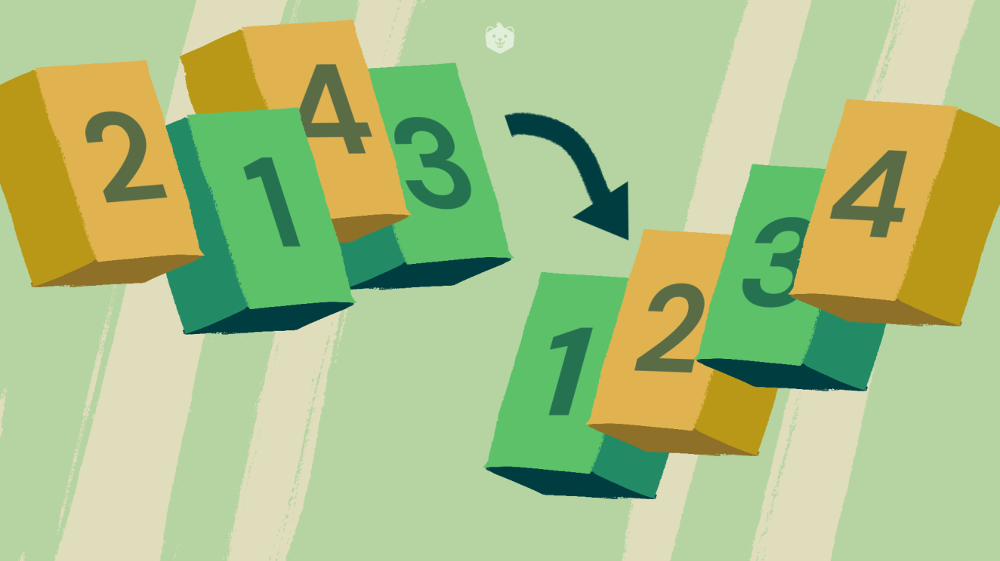
Sorting: Definition and Processes
– Role of sorting in Modern World:
– Enormous amount of data
– E-commerce (Amazon, Ebay)
– Network traffic (telecom billing, monitoring)
– Database transactions (Sales, inventory)
– Scientific measurements (astrophysics, geology)
– Sensor networks. RFID tags
– Bioinformatics (genome, protein bank)

Slide 6
Sorting: Definition and Processes
– Role of sorting in Modern World:
– Communication in the Internet
• Message (email, ftp) broken down into IP packets.
• Sender/receiver identified by IP address.
• The packets are routed through the Internet by special computers called Routers.
• Each packet is stamped with its destination address, but not the route.
• Because the Internet topology and network load is constantly changing, routers must discover routes dynamically.
• What should the Routing Table look like

Slide 7
Sorting: Definition and Processes
Searching is an essential operation:
Several ways
Algorithms that search for an element within a collection:
Linear search
Binary search

Slide 8
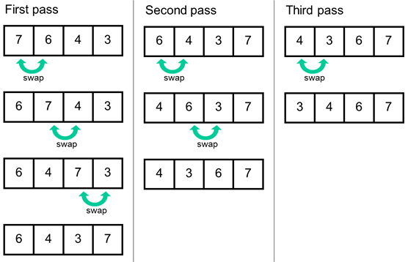
Bubble Sort

Slide 9
Bubble Sort

Slide 10
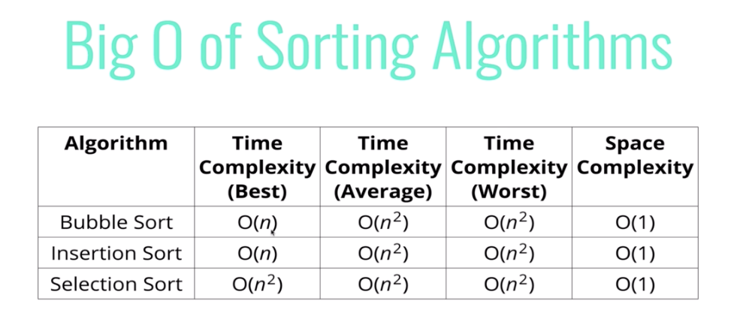
Bubble Sort

Slide 11
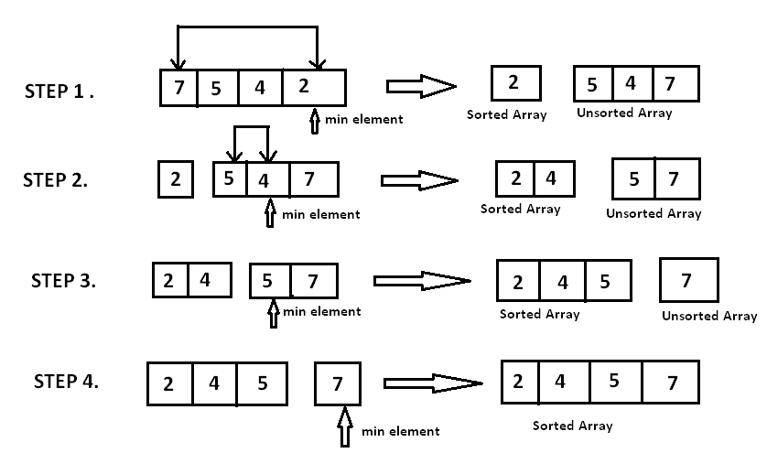
Selection Sort

Slide 12
Selection Sort

Slide 13
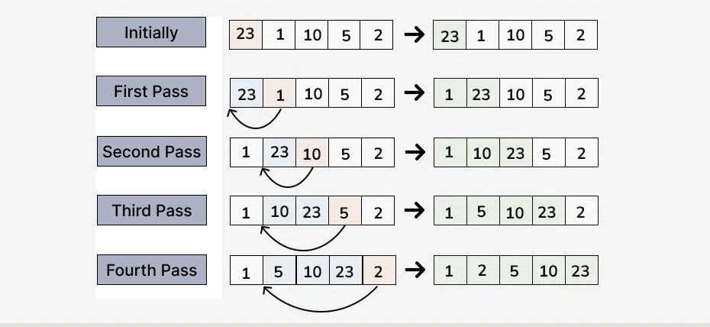
Insertion Sort

Slide 14
Insertion Sort

Slide 15
Insertion Sort

Slide 16
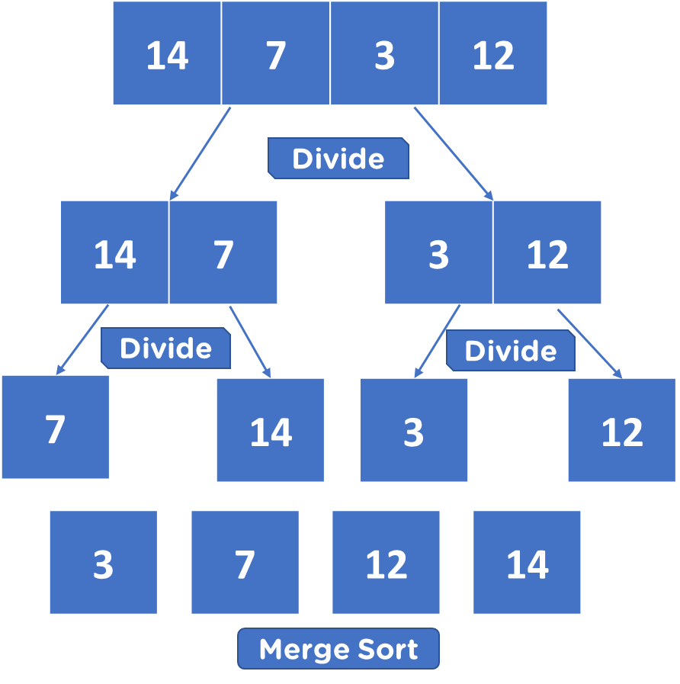
Merge Sort

Slide 17
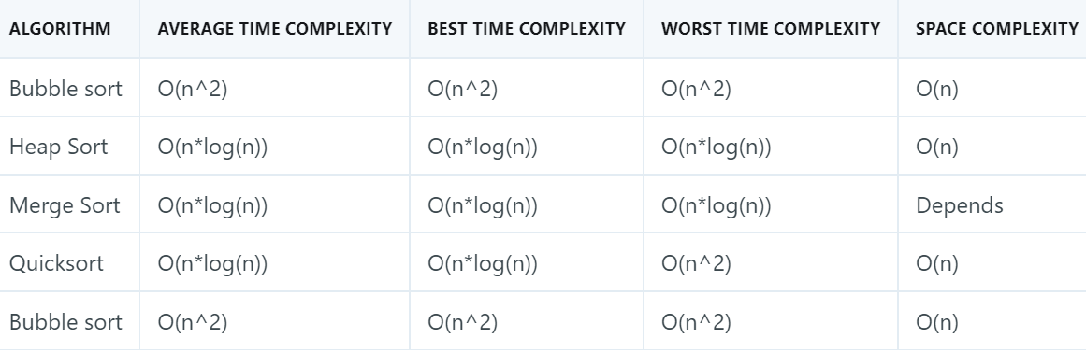
Merge Sort

Slide 18
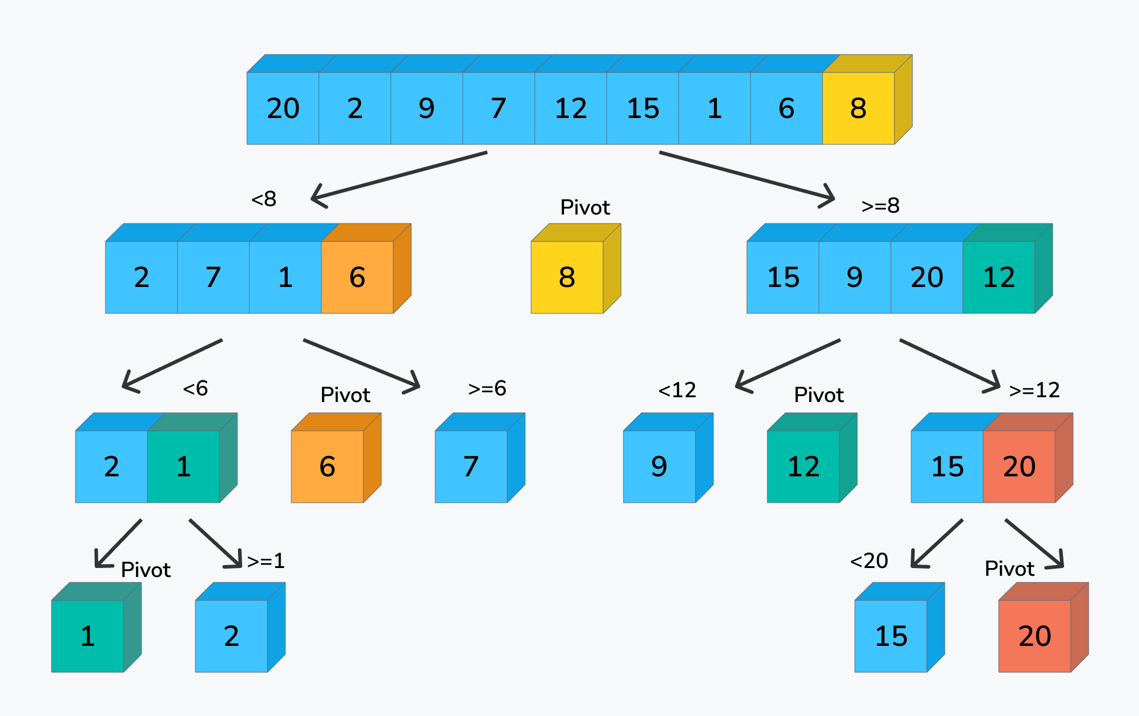
Quick Sort

Slide 19
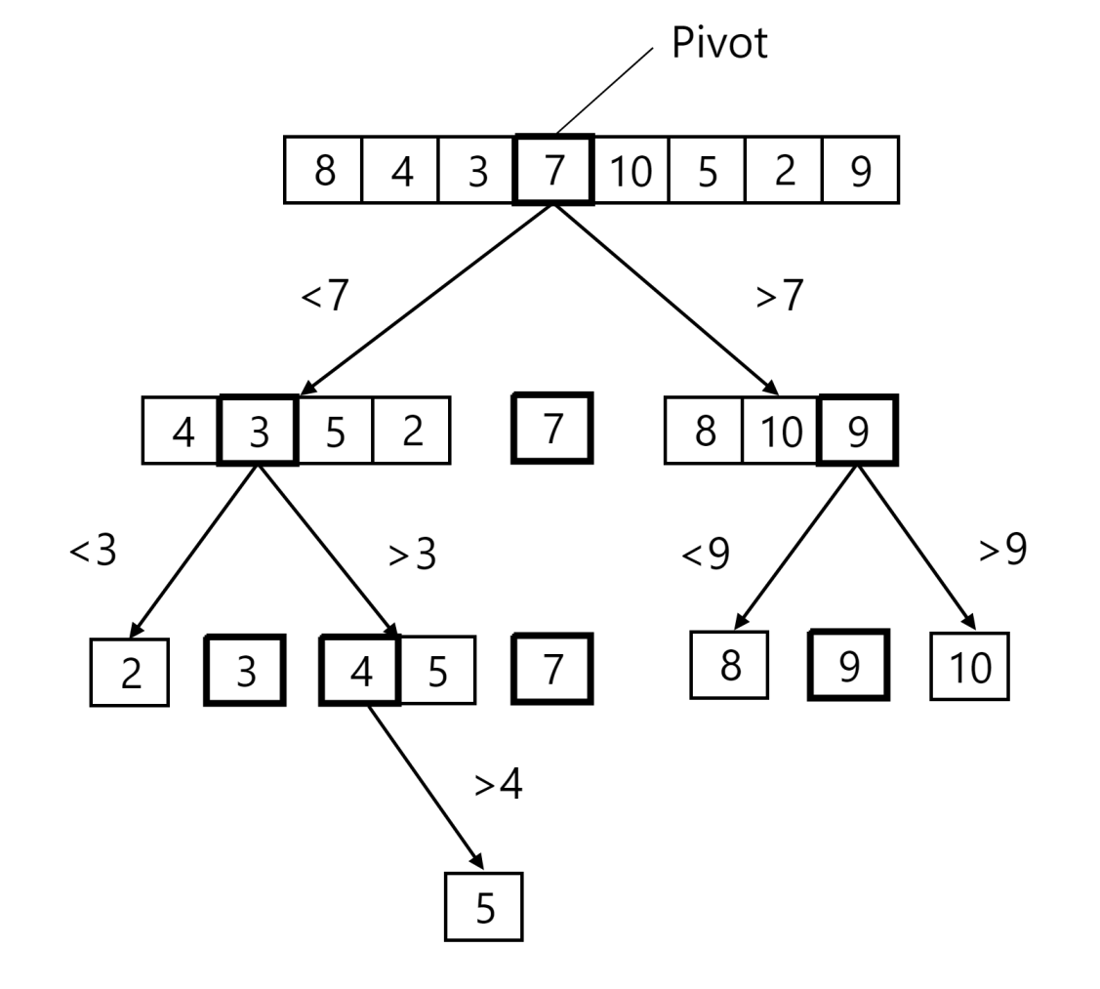
Quick Sort

Slide 20
Quick Sort

Slide 21
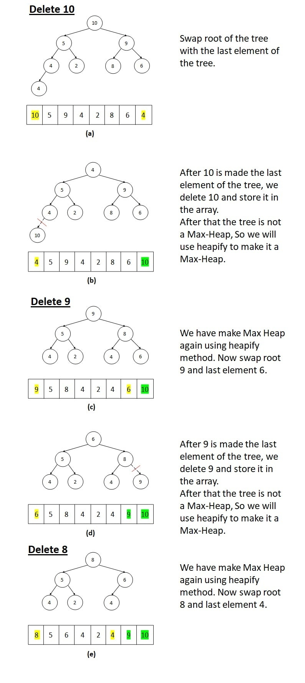
Heap Sort

Slide 22
Heap Sort

Slide 23
Heap Sort

Slide 24
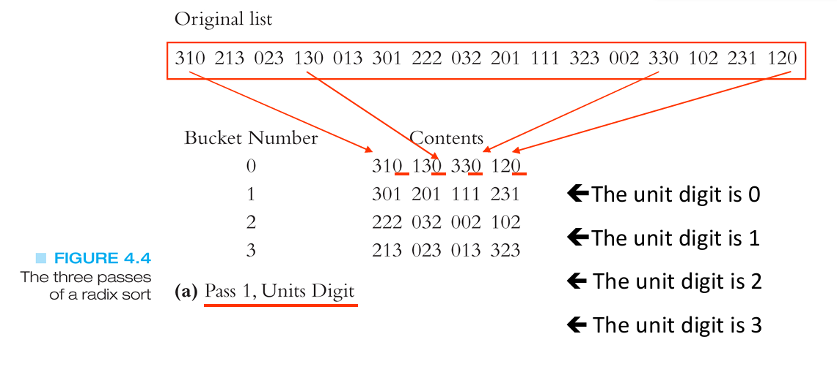
Radix Sort

Slide 25
Radix Sort

Slide 26
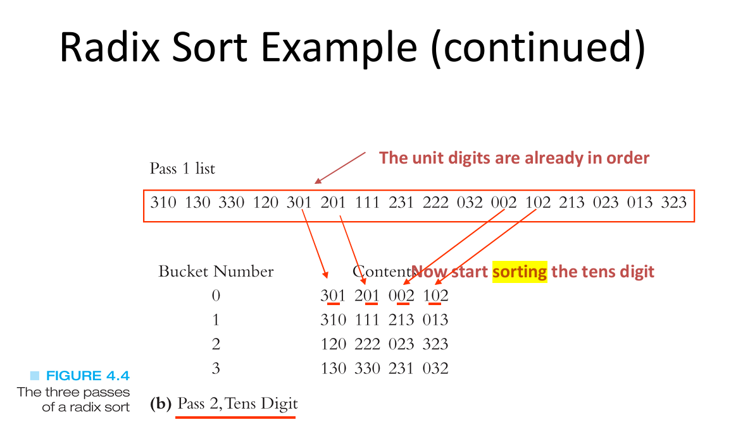
Radix Sort

Slide 27
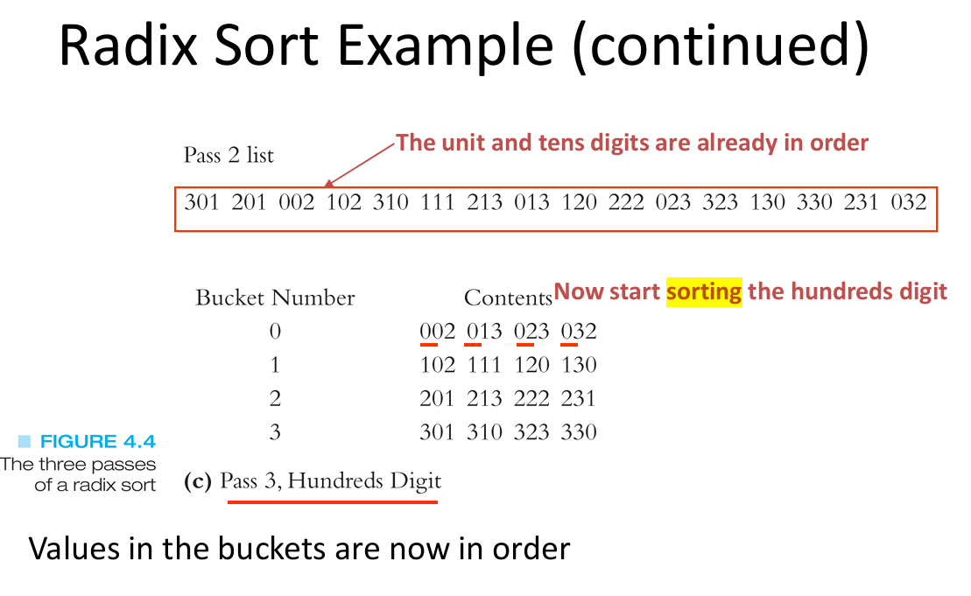
Radix Sort

Slide 28
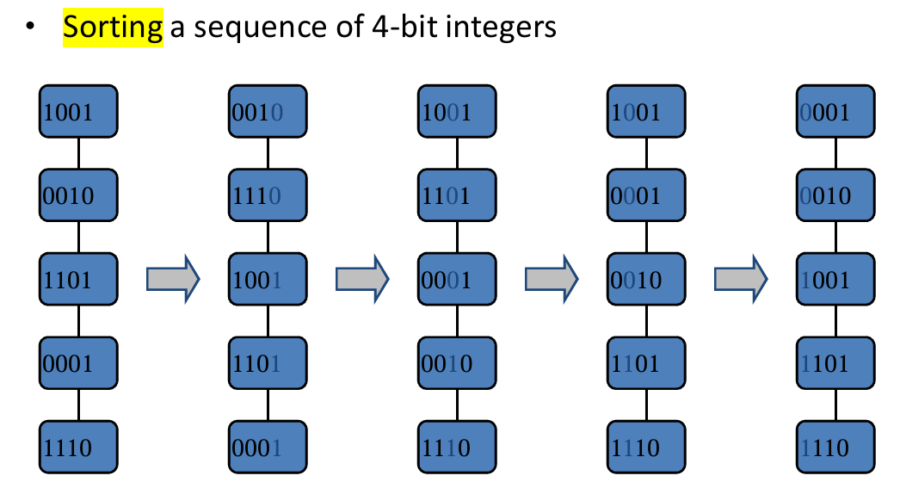
Radix Sort

Slide 29
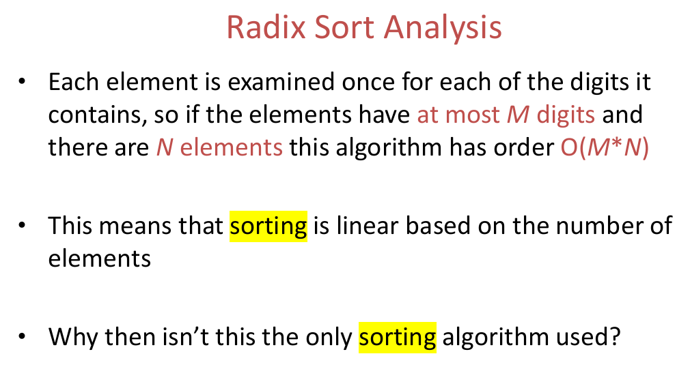
Radix Sort

Slide 30
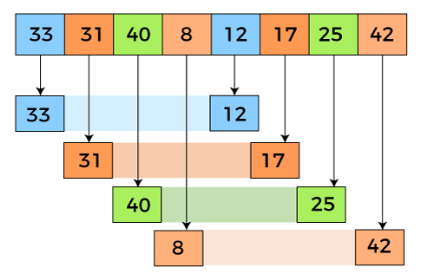

Shell Sort

Slide 31
Shell Sort

Slide 32
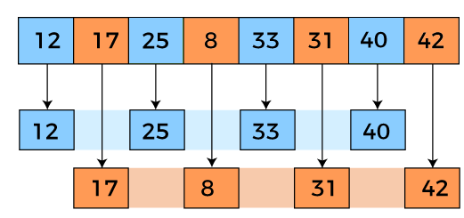

Shell Sort

Slide 33
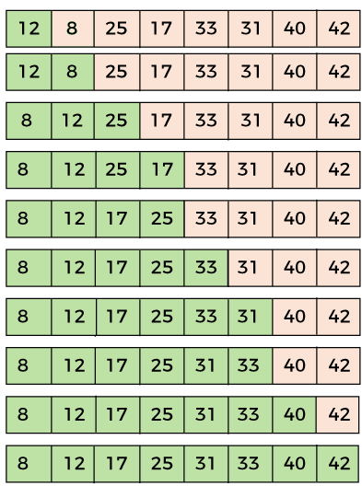
Shell Sort

Slide 34
Shell Sort Complexity
Time Complexity:
The time complexity of Shell Sort depends on the gap sequence used.
In the worst case, it's generally considered between O(n^2) and O(n^(4/3)).
Space Complexity: Shell Sort is an in-place sorting algorithm, meaning it doesn't require additional memory proportional to the input size.
The space complexity is O(1) as it uses a constant amount of extra

Slide 35
Thanking you !!!!
Any question !!!!!
Download PPT : https://github.com/sachin365123/Applies-Data-Structure-and-Application-GLA-Online-Sessions-Jan---Jun-2026

